Slide 1
UNLEASHING THE CREATIVE VOICES: EMPOWERING CHILDREN WITH THE RIGHT TO EXPRESS THEMSELVES

Slide 2
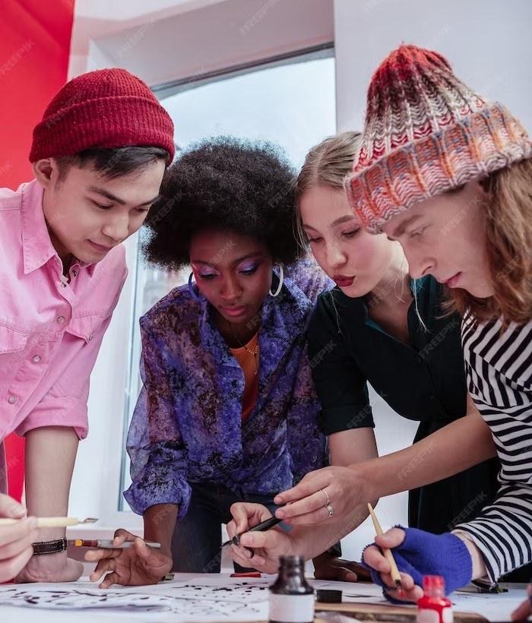
INTRODUCTION
Unleashing the Creative Voices: Empowering Children with the Right to Express Themselves

Slide 3
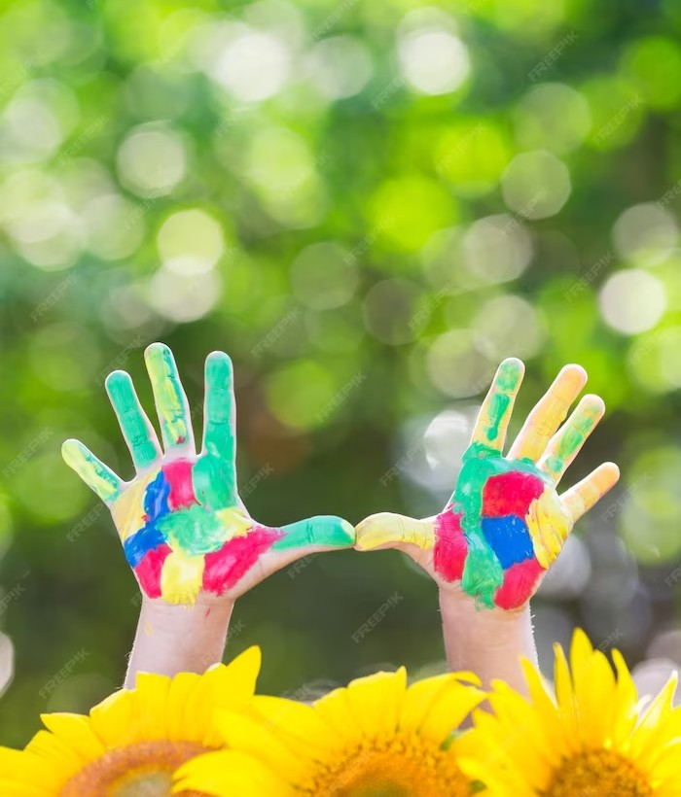
IMPORTANCE OF CREATIVE EXPRESSION
Unlocking creativity in children is crucial for their holistic development. It fosters self- expression, problem-solving, and innovation. Creative expression allows children to communicate their thoughts, emotions, and perspectives in unique ways, building their conﬁdence and critical thinking skills.

Slide 4
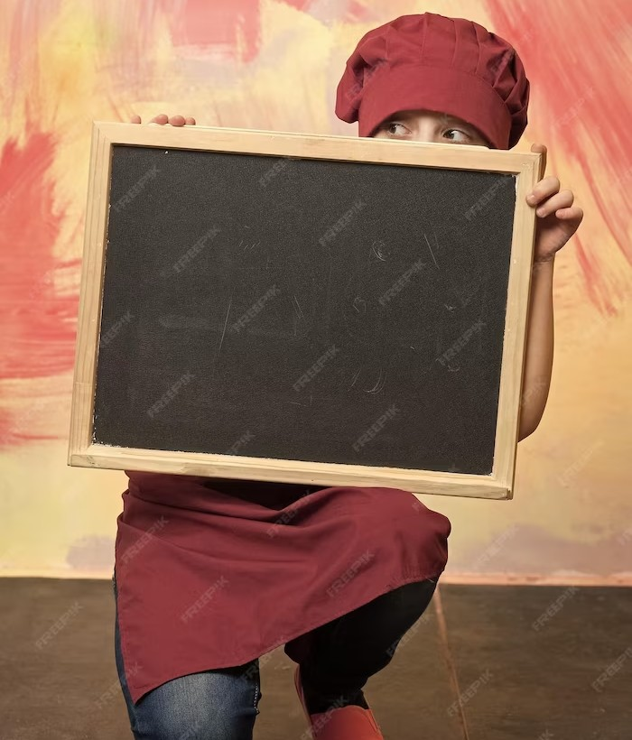
CHALLENGES FACED
Despite the signiﬁcance of creative expression, children often face barriers such as limited resources, lack of support, and social norms.
These challenges can hinder their ability to explore and express their creativity fully.

Slide 5
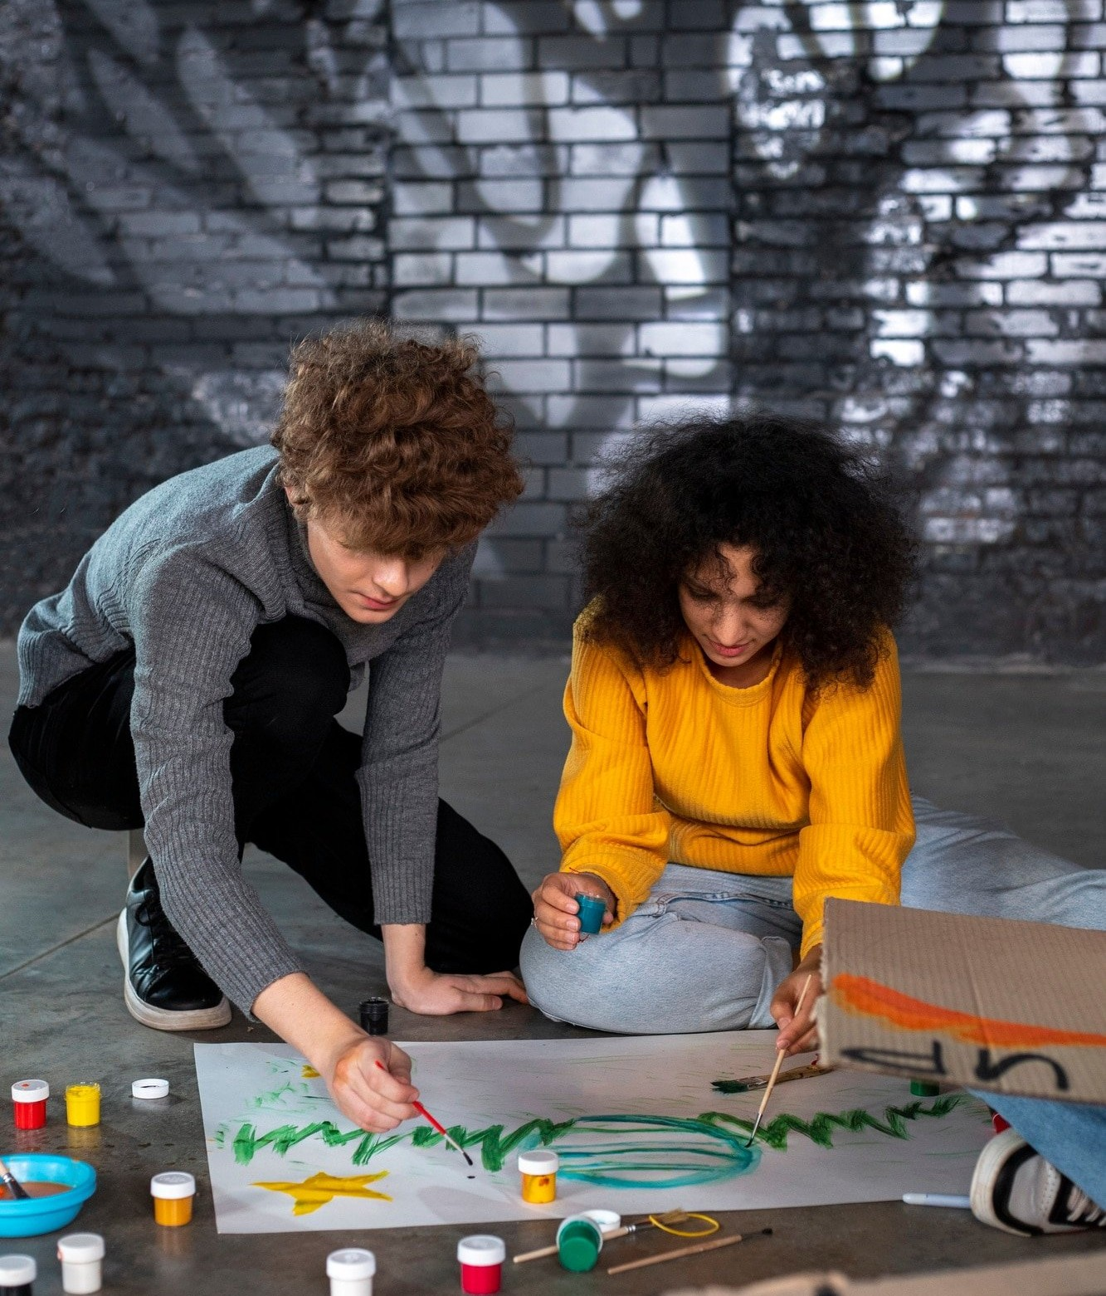
EMPOWERING CHILDREN'S VOICES
By providing accessible platforms, encouragement, and inclusive environments, we can empower children to embrace their creative voices. Let's create a world where every child has the right to express themselves and their ideas freely.

Slide 6
CONCLUSION
Unleashing the creative voices of children is not only a right but also a necessity. By nurturing their creativity, we enable them to become innovators, problem solvers, and change-makers. Let's commit to creating a future where every child can freely express themselves and contribute to a more vibrant and inclusive society.

